Slide 1

North American Energy Standards Board
Mission & Government Coordination
Background
Mission: The North American Energy Standards Board serves as an industry forum for the development and promotion of standards to support the wholesale and retail natural gas and electricity markets
1994
2001
GISB
Founded
NAESB Established
Department of Energy
National Petroleum Council
National Institute of Standards and Technology
Federal Energy Regulatory Commission
North American Electric Reliability Corporation
National Association of Regulatory Utility Commissioners
30+
4,000+
Years of Standards Development
Standards
American National Standards Institute Accreditation
Oct. 2001

Slide 2





Membership, Structure & Products
NORTH AMERICAN ENERGY STANDARDS BOARD
Our Areas of Focus
WHOLESALE ELECTRIC
RETAIL MARKETS
(GAS & ELECTRIC)
WHOLESALE GAS
2000+ Market Standards
9 Publications Since 2005
Market Participation
End Users
Distribution/LSE
Transmission
Generation
Marketers/Brokers
Independent Grid Operators
Technology and Services
The Electric Industry Registry
e-Tag Functional Specification
1700+ Market Standards
11 Publications Since 2005
Market Participation
Retail Electric End Users/Public Agencies
Retail Electric Utilities
Retail Electric Service Providers/Suppliers
Retail Gas Market Interests
600+ Market Standards
16 Publications Since 1996
Market Participation
End Users
Local Distribution
Pipelines
Producers
Services
Common Coding System for Interstate Pipelines

Slide 3
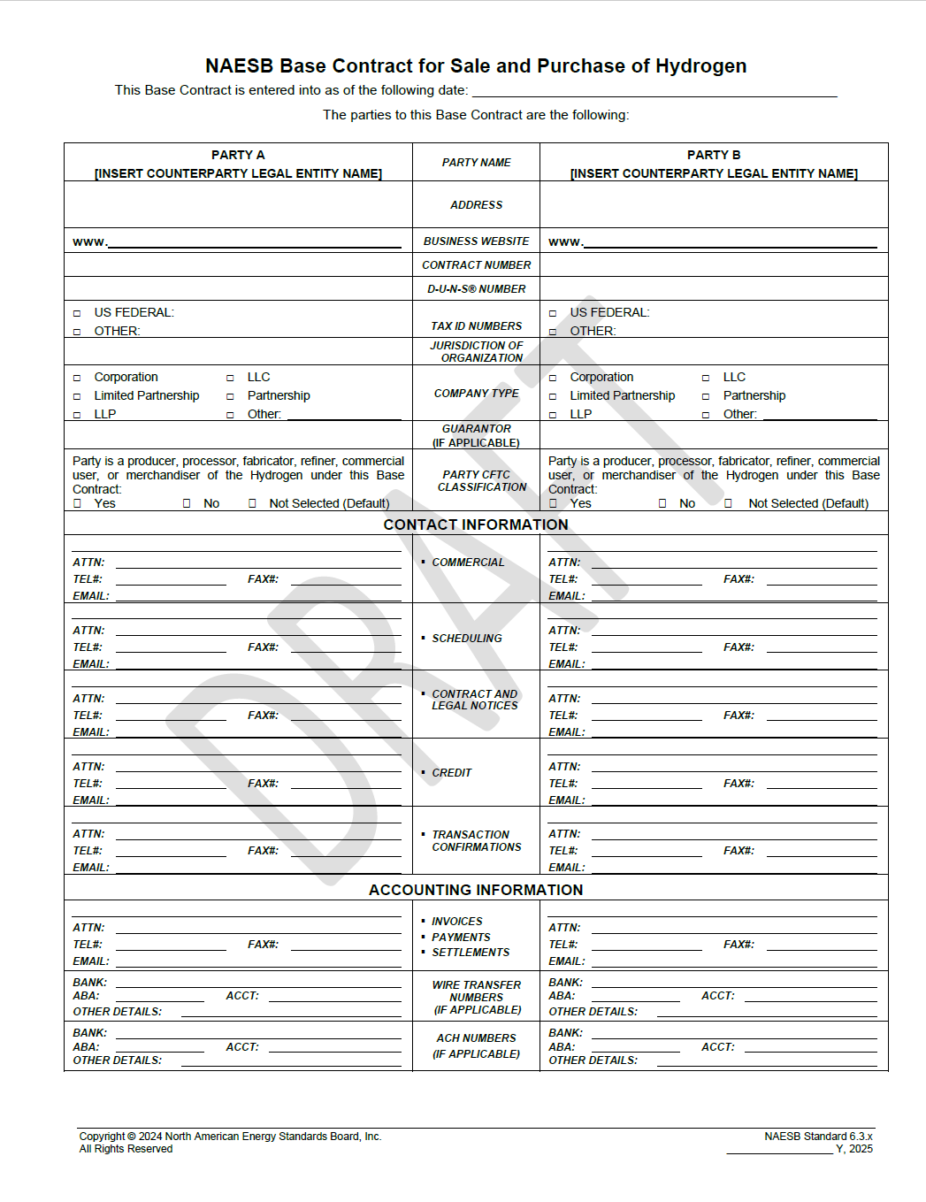
NAESB Standard Base Contract for Sale and Purchase of Hydrogen
Background & Development Information
Overview
WGQ Contracts Subcommittee kickoff meeting was held July 11, 2024
Based on the NAESB Base Contract for Natural Gas, Natural Gas Liquids, and Certified Gas Addendum
WGQ Contracts Subcommittee meetings lead to a Revised NAESB Standards Recommendation on October 10, 2025.
NAESB WGQ Executive Committee reviewed and passed the Base Contract for Purchase and Sale of Hydrogen including FAQs and Canadian Addendum on October 22, 2025.
Base Contract for Purchase and Sale of Hydrogen was ratified by NAESB membership and was available as a NAESB Standard in November 2025.

Slide 4
NAESB Planned Effort on an Ammonia Addendum to H2 Base Contract
Background & Development Information
Overview
On December 16, 2025 the Clean Hydrogen Buyers Alliance (CH2BA) filed a request for NAESB to develop an Ammonia Addendum to the Base Contract for Purchase and Sale of Hydrogen
The request was designated as R26001 and assigned to the WGQ Contracts Subcommittee for the standard development.
Meeting with CH2BA and the Ammonia Energy Association are being conducted in March 2026 to develop a strawman for NAESB’s development effort.
NAESB plans for the initial kick-off meeting to be held March 31, 2026.
Current plans development meeting to be held on a 2-3 week cycle with an anticipated recommendation to WGQ Executive Committee in June 2026.

Slide 5


Contact Information
Website: www.naesb.org
Phone – 713-356-0060
Fax – 713-356-0067
Email – naesb@naesb.org
For further information on the organization, please contact NAESB Staff at 713-356-0060 or naesb@naesb.org.
NORTH AMERICAN ENERGY STANDARDS BOARD

