Slide 1
NAESB DER Registry WG
November 17th

Slide 2
Conversation for today
Guiding Principal Discussion
  Use of Existing Standards
  Path forward for a NAESB Registry Standard
Review High Priority Ranking Items
  Stakeholders/Entities – Is there anything missing?
  Discussion on Interactions with Stakeholders and Registry
Discussion

Slide 3
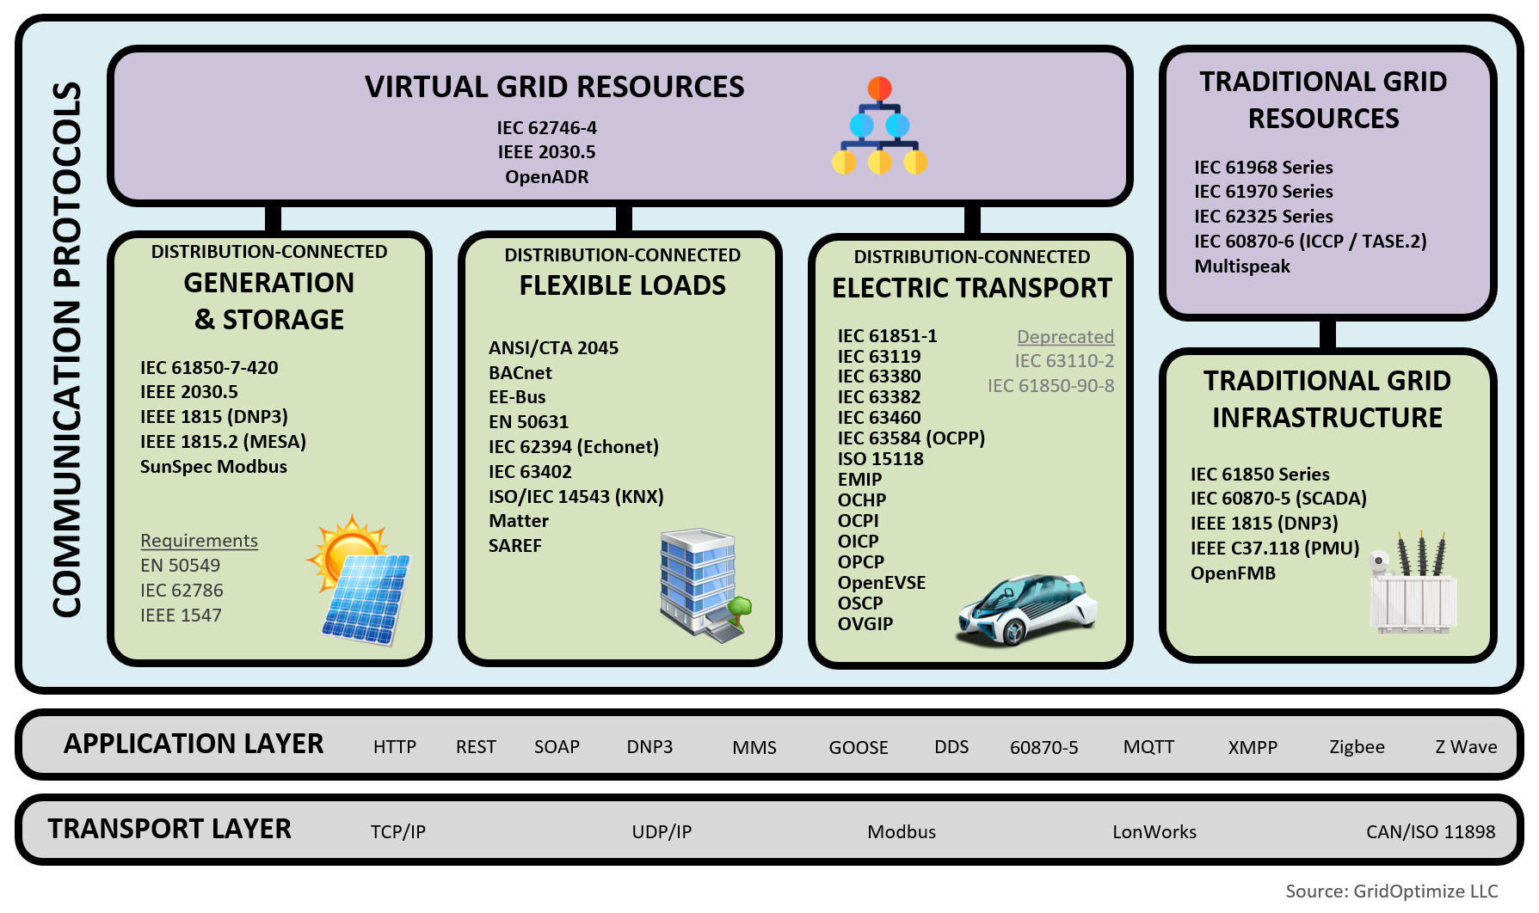
Guiding Principal:
Attempt to utilize existing standards
Minimize ‘re-inventing the wheel’

Slide 4
Guiding Principal:
Path Forward for a NAESB standard
Validate Stakeholders/Entities
Validate Interactions between Stakeholders
  Interactions with Registry
    Data Read/Write/View concepts – Who ‘owns’ the data, who can change the data, who can view the data, what data may need someone to input but also requires someone to validate?
    What data comes from which stakeholders
  Interactions with other Stakeholders
    What Stakeholder to Stakeholder interactions need to be in a Registry?
We can’t ‘boil the ocean’ – Perfect is the enemy of the Good
  What is the MVP for the Registry that takes our spreadsheet from action to a NAESB/MVP Standard to provide the ‘starting point’

Slide 5
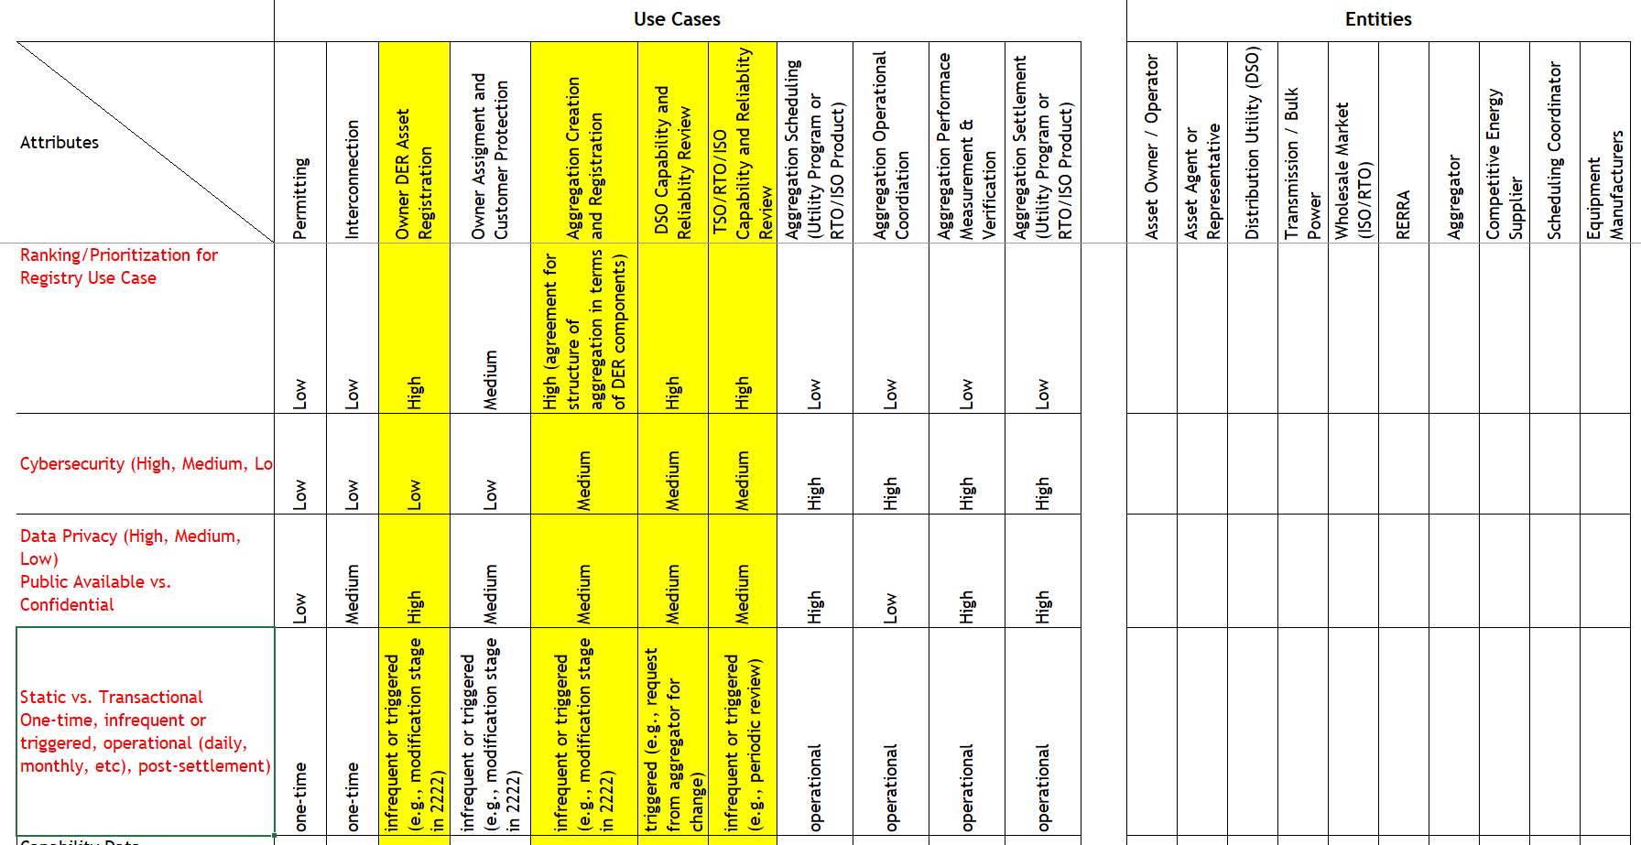
High Priority Ranking Items

Slide 6

Any stakeholder missing?

Slide 7
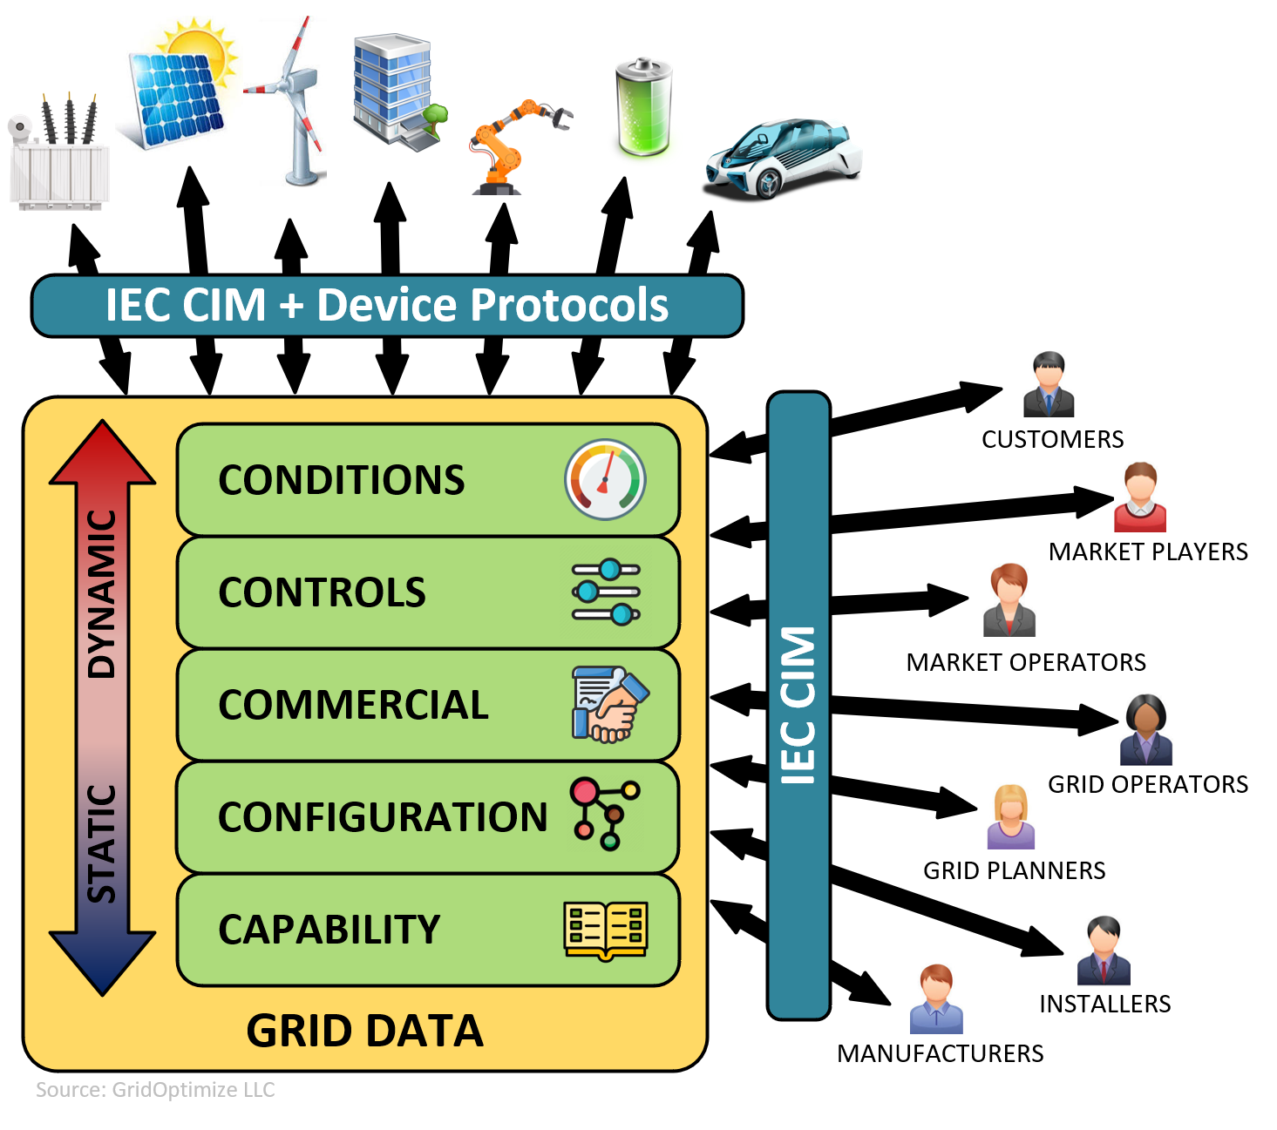
Interactions Discussion
Priority and Focus of Registry for High Priority Items are in the dashed red box
Static Data (Asset info, Capability, Configuration and required Commercial Data for ownership/registration/etc. is the focus of the Administrative Registry – Not Dynamic Data (operational data or commercial settlement data)
Data Input/Modification/Viewing (Read/Write/View) Discussion
  Interactions with Registry
    Data Read/Write/View concepts – Who ‘owns’ the data, who can change the data, who can view the data, what data may need someone to input but also requires someone to validate?
    What data comes from which stakeholders
  Interactions with other Stakeholders
    What Stakeholder to Stakeholder interactions need to be in a Registry?

Slide 8
MVP/NAESB Standard Discussion
We are not going to get it ‘right’ the first time but working for years to get it right vs getting the MVP will not help industry
How do we get from where we are at to a NAESB Registry Standard?

