Slide 1
Collaborative Non-Profit DER Registry Briefing
CHRIS.HICKMAN@CUSLN.ORG

Slide 2
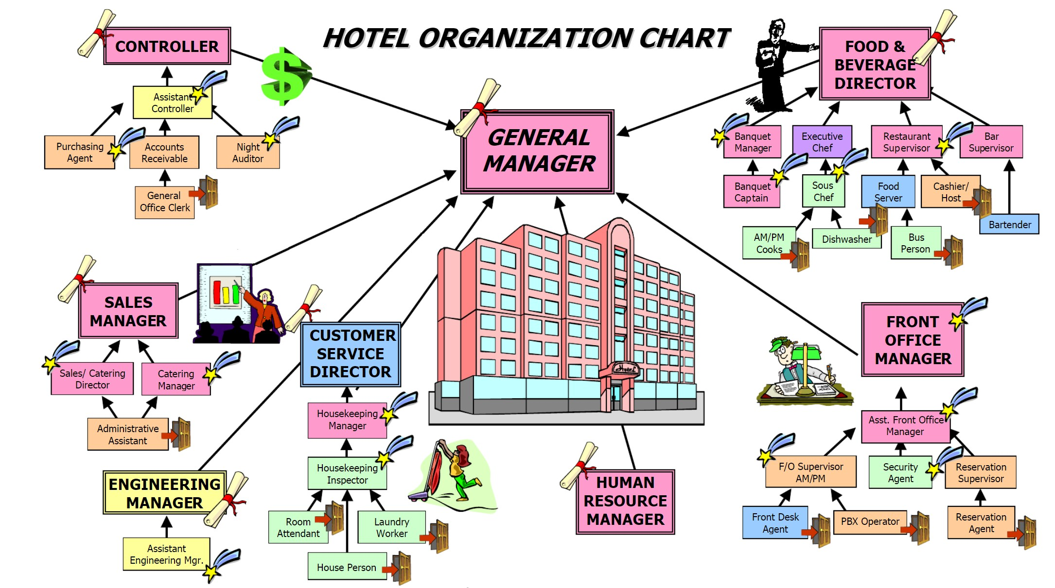
Why Share Data and Who Makes the Call?
Makes perfect sense to all of us that the General Manager would want to see all of the data from all groups, right?
Does it make sense that the Hilton CEO would want to see data from all hotels?
Does it make sense that key suppliers would have access to some of the data?
Now think of each hotel like a power plant:
  Anyone here go through the process of getting groups to share data at a plant? Or across all plants?
  Or getting different silos of your utility to share data or plan for a common system?
Now think of DERs, not personally from where you sit in a part of an organization, but from the overall grid reliability, safety, affordability and sustainability. If you sit in a DSO, you may not want to share your information, but if you sit at NERC or an ISO, you know that you also need that information for overall grid reliability.

Slide 3
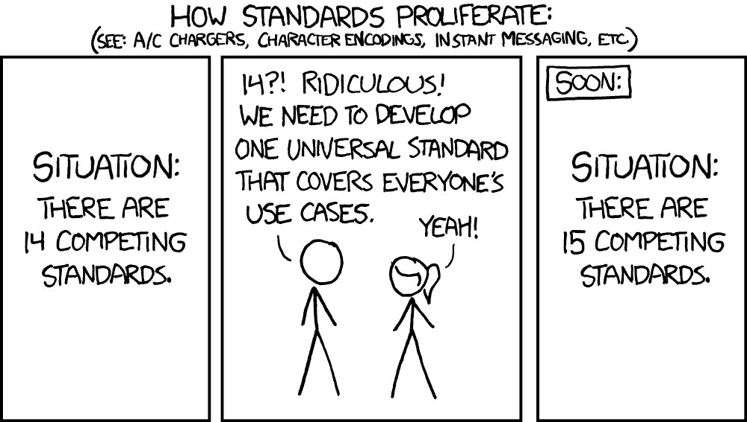
Collaboration Must Increase
We have the opportunity to get in front of this and simplify through collaboration

Slide 4
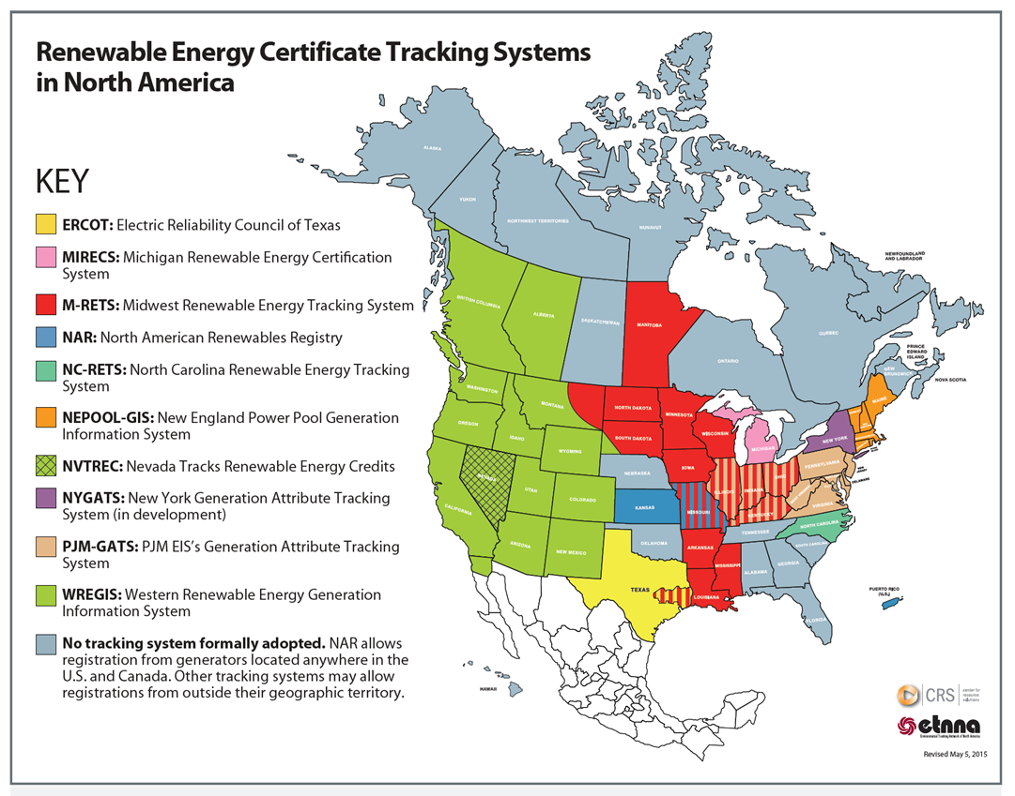
A step in the right direction – Partial Collaboration with REC Tracking Systems
Dozens of REC tracking programs initially. 11 made it to the mainstream
Many states forced to use multiple systems across different ISO’s.
The Non-Profit DER Registry is an opportunity to fully collaborate. Allowing us to skip over years of ad hoc development, implementation and confusion.
In addition, AI will soon give us enormous power to marshal DER resources. But that can only happen efficiently if the data is accurate, and consistent/normalized across multiple systems. The resulting ecosystem would provide the requisite situational awareness that otherwise eludes multiple parties that need it.

Slide 5
Multi-Use
Multi-Player
DER DATA
Permitting
Interconnection Agreement
Aggregation Creation and Management
Aggregation Registration & Approval into a retail/market program
Reporting
Change Mgmt (Move in & Move out, network reconfig, etc.)
Planning & Modeling Systems (Utility & ISO)
GIS systems
EMS System (Operational and Market)
Settlement Systems
Isolated Efforts by any single group or function create barriers to successfully enable DERs
Unlike unbundling in FERC 888/889 that represented ~12,000 generation facilities, DERs represent millions of devices across millions of customers

Slide 6
Multi-Use
Multi-Player
DER DATA
Customer or Owner of DER
RTO/ISO
Regulator
Consulting Groups supporting Industry
Industry Software Providers
DSO
TSO
Equipment Manufacturer
Other Governmental
(EIA/DOE/etc)
Registry must be designed for collaboration and coordination with distinct login, security, support of the different stakeholders that are required to enable DERs to grid and market

Slide 7
ISO - Aggregator Interface
$25M+$5M/yr
Aggregator –
Utility Interface
$3.75B + 750M/yr
The Cost of Business as Usual:
$12BN + $2.6BN/yr
Over 3,000 utilities, the RTOs/ISOs and Aggregators will have to independently create and maintain their own systems. Functionality limited to ‘their scope’.
DER Enablement to utility programs and market products inhibited by administrative processes of interface and information exchange
Provides no direction for existing utility system software vendors to improve their systems for DER data use and exchange
Costs are significant and escalating
ISO - Utility Interface
$150M + $30M/yr
Utility3
Utility2
Utility4
Utility1
Utility-n
ISO
Aggregator1
Aggregator-n
Aggregator2
Aggregator4
Aggregator3
Internal ISO/Utility Systems Interface
$5.2B + $1.05B/yr
First cost of building Systems
$3B + 750M/yr

Slide 8
Empower the Energy Transition
Through
Simplification and Collaboration
Deliver a national collaborative DER registration system, saving billions of dollars for our industry and customers
Implement standardized and secure data exchanges, enabling information sharing and easing regulatory reporting.
Automated DER & DERA policy enforcement and approvals for both retail programs and market products
Provide leadership and education from board and industry experts, preparing everyone for a DER enabled future

Slide 9

What’s in a Registry and Why?
Process must be ‘physics based’ not ‘policy based’. Can’t be hung up by naming conventions, market structures, and corporate structures. What is the core data required to enable DERs to make it all work?
REQUIREMENTS
Requirements pouring in by the dozens/hundreds
Each major group and their subgroups have their own concepts
Pre-
Competitive
DER
Registry
Aggregators
Customer Service
Distribution
Customer
Equipment
Interconnection
Transmission
Regulatory
Trading
Generation
Operation
Maintenance
Cost
Programs
etc
etc
All ISOs have different approaches but have to operate across them all
Systems integration with all
Customer Interaction
Business Models
Etc
Regulator
Federal vs State
New rules/tariffs/etc
Customer protection
Utility cases
Etc
ISO
FO 2222 Compliance
Systems
Tariffs – Market Products
Operations
etc
Utility
The Base Data Set required for all stakeholders.

Slide 10
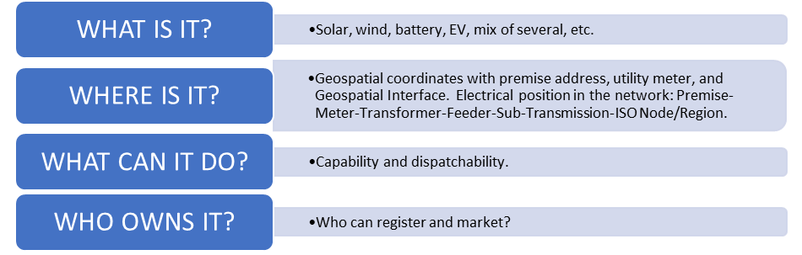
Shared Data: Enabling DERs through Collaboration
To meet the challenges before it, the industry must know:
  All stakeholders (Utilities, ISOs, Aggregators, Scheduling Coordinators, Competitive Retail Electric providers, etc.) must have fair and equal access to the data they need based on appropriate regulatory authority oversight which determines which data elements in a registry are available to each stakeholder.

Slide 11
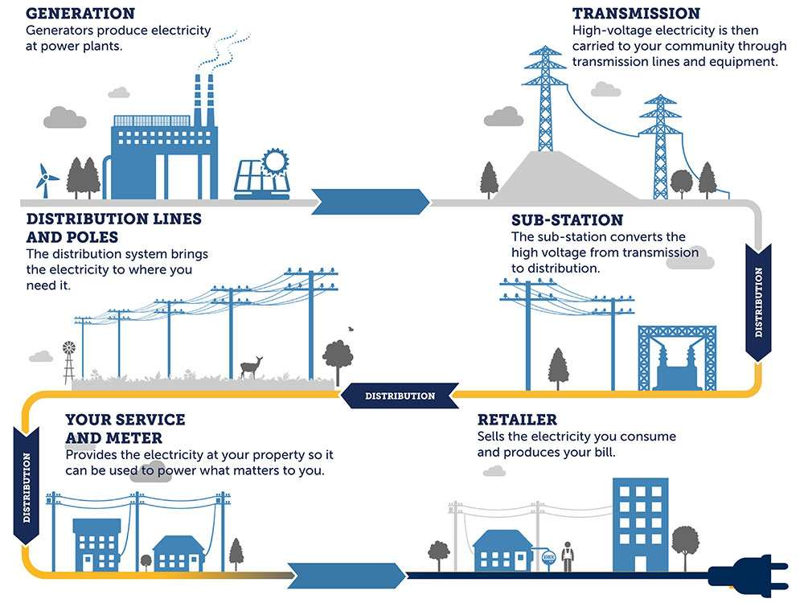

Three Key Interfaces of Data Exchange for DER
Interface | System Description | Business Description
1 | EHV/Bulk Electric System interface to Distribution System at the Substation | ISO/RTO operations and planning interface to Distribution Utilities at the Substation
2 | Distribution System interface to Premise at the Meter | Utility/Retailer interface to Consumer at the meter
3 | Market Systems | DER Interface to Market and Utility Programs
1
2
3
Market/Program

Slide 12
The Registry must be built with CIM in mind
The Common Information Model (CIM) was developed as an open standard for representing power system components. CIM was originally developed by EPRI in North America and is now a series of standards under the International Electrotechnical Commission (IEC)
This format has been adopted by the major EMS vendors.
Solving the ‘DER Interface’ is the exact same issue, just for millions of small generators vs tens of thousands of big generators.
“déjà vu all over again”
– Yogi Berra
Solving the same exact problem but for millions of generators instead of a few thousand. Will it take us another decade?

Slide 13
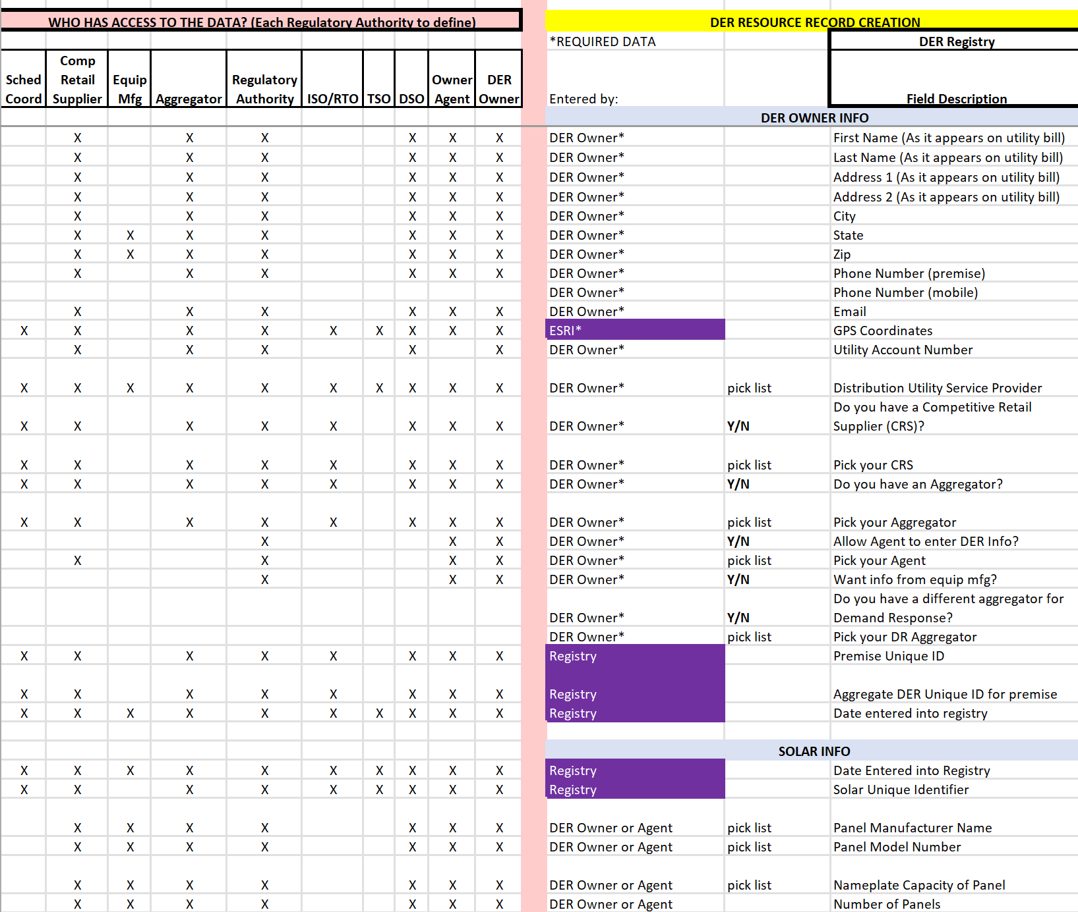
Data Access, Privacy and Consumer Protections
Data Access to the information in the DER Record is determined by each appropriate regulatory authority. The Registry allows this dynamic ability for each regulatory authority to define who shall have access to each data element in the Registry. Registry also implements each ISO, State or Utility Data Privacy Agreements.

Slide 14
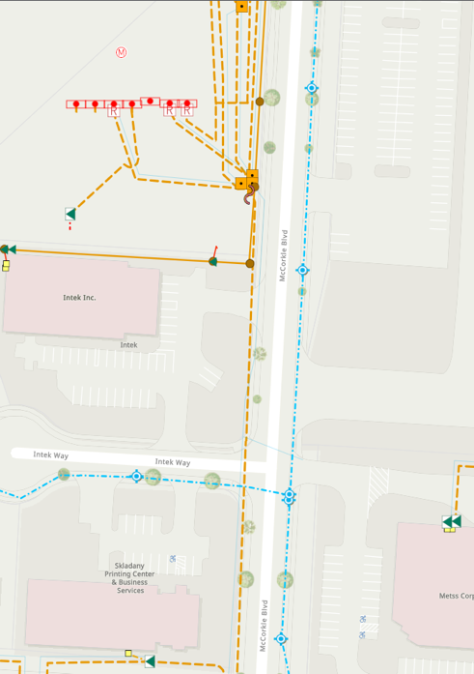
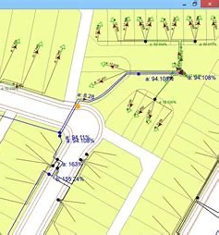
GIS capability is needed for visualization
Different stakeholders will have different views, but this graphical interface allows rapid incorporation into grid planning and operational tools through CIM and Esri tools out of the box without custom interface.

Slide 15
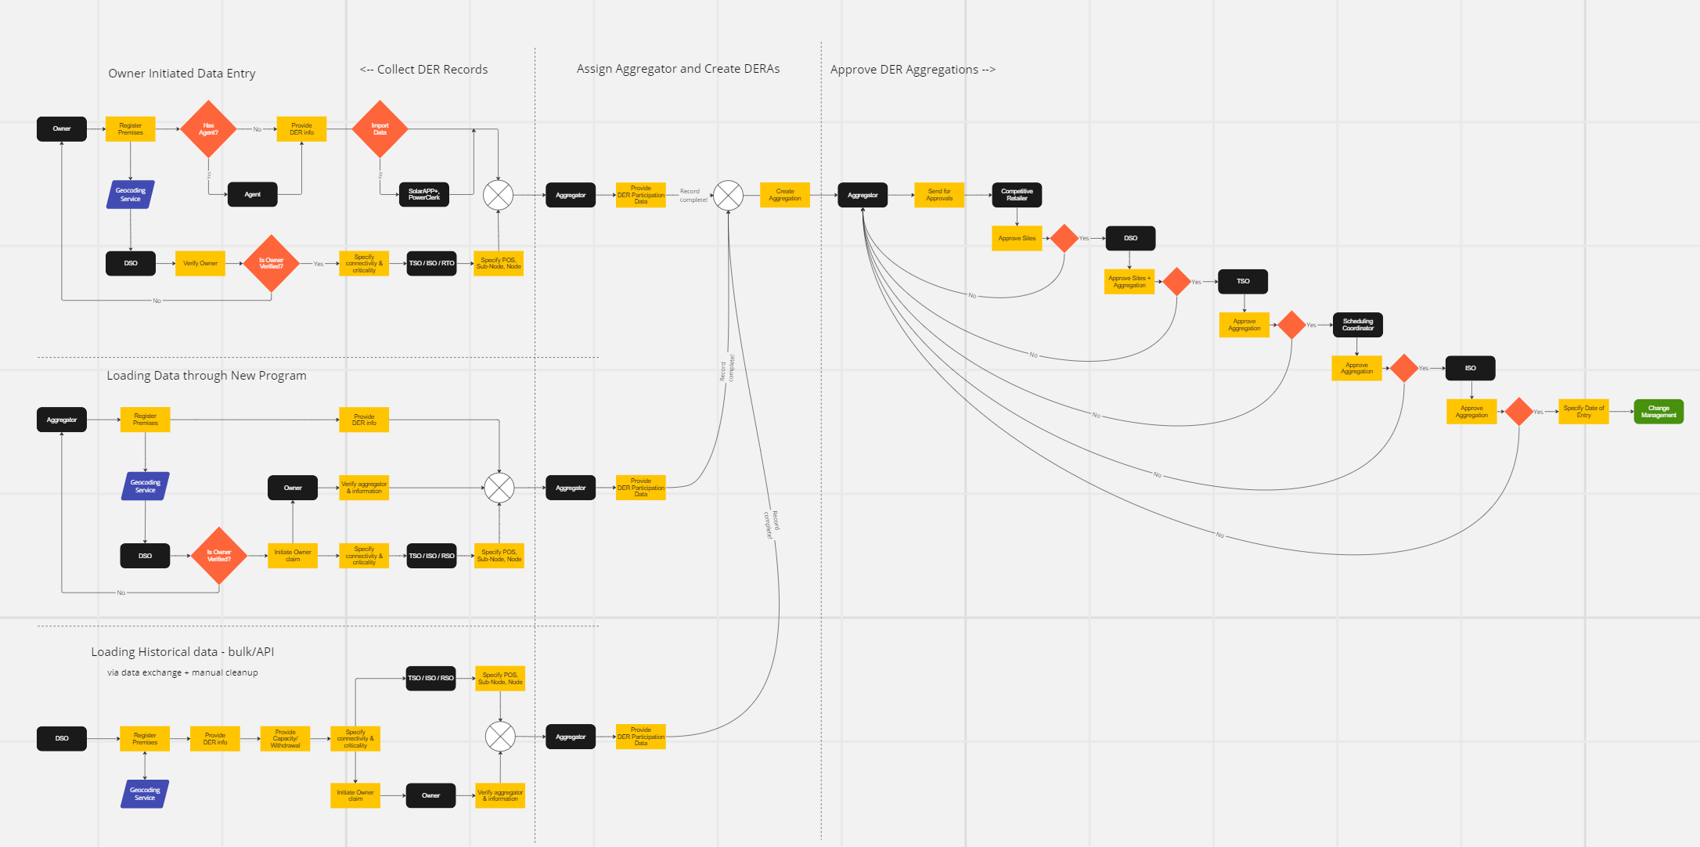
DER Data Collection and DER Aggregation Administration
Three Versions of Data Entry to Registry
Customer/Agent entered
  Auto and SolarAPP+/PowerClerk coming soon
Aggregator entered through program
Historical Utility Data Upload
Input from SolarApp+ or PowerClerk (not shown)
Dynamic Approval and Aggregation Process. Allows different processes in each market or utility program

Slide 16
DER Registry: End to End Solution
DER Registration - Complete Administrative Process
What is it?
Where is it?
What can it do?
Who owns it?
Enablement and validation of Aggregator selection and acceptance of applicable data privacy requirements
Aggregation
Who is aggregator?
What is aggregation?
What is it registered for with utility retail program and/or market product?
Approval by all required parties.
Change Management
Grid changes for electrical placement
Change of Aggregators
Change of Aggregations and registration for different utility or market programs
Updated DER info for any premise, Move In/Out
Reporting
Fully automated reporting.
Eliminating 100% of the time and effort of all utilities, ISO’s and stakeholders to report DER information to any regulatory authority as they will all have direct access to the system.
Dispute Resolution Tracking
Approval
Defined approval process by utility program or ISO product
Tracking during approval by everyone in the approval chain
“Time-bound” can implement min/max time for each review

Slide 17
Summary
Where you ‘sit’ defines your view of ‘what is necessary’. However, DERs effect every aspect of the industry and the view of ‘what is necessary’ must be broadened if the industry has any chance of successfully enabling DERs to the grid and market
Current projections from DOE and others show us 100GW-300GW short of necessary capacity on the grid in the next 10 years. DERs must become a real part of the overall resource mix to help bridge this gap for the US.
Takes significant effort for people to step outside of their current role and take the steps to effectively collaborate but regulators and standards groups must proactively ‘step up’ to help everyone reach a successful outcome going forward.

