Slide 1
WELR Timing and Process for New E-Tags

Slide 2
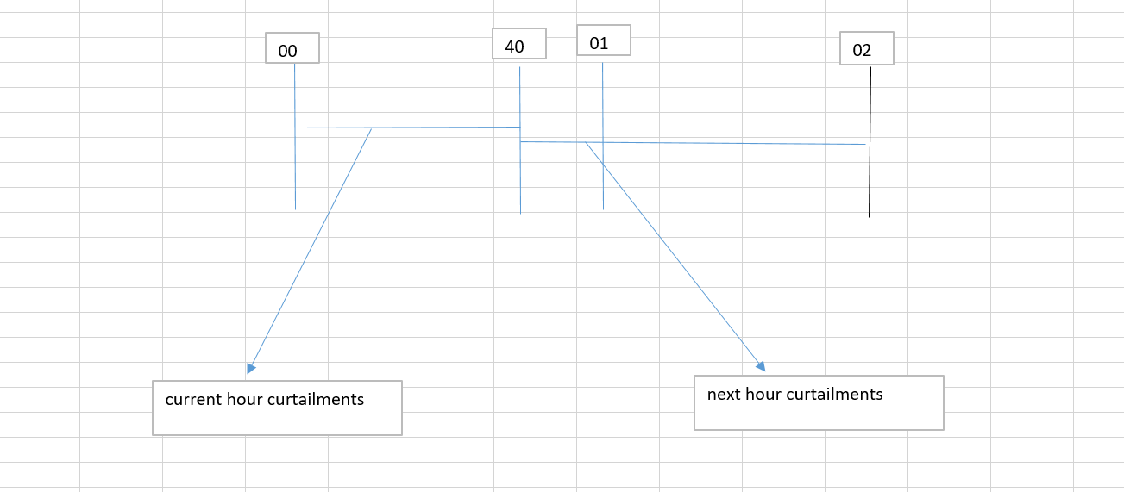
WELR Effective Timings and New E-Tags
As drafted currently when RC issue WELR curtailments between 00 and 40 minutes in the current hour curtailments will trigger curtailments for the current hour and any issuance after 40 minutes will result in next hour curtailments.

Slide 3
WELR Effective Timings and New E-Tags
In western interconnections tags could be submitted until 20 minutes before the start of the transaction.
Any new e-tags submitted during when WELR is active and their impacts are less than 5% threshold on the constraint that WELR is active the new e-tags will not be hold and they will flow.
Any new e-tags submitted during when WELR is active and their impacts are grater than 5% threshold on the constraint the new e-tags will not be allowed to flow .

Slide 4
WELR Effective Timings and New E-Tags
What if WELR is only curtailing non firm tags and non firm GTL do we allow new firm tags to be flown or simplify the process and not allow them to flow?

